Slide 1


Netflix Content Strategy Analysis
- A Case Study by Imon Ghosh

Slide 2

CONTENTS
Case Study
Research Objective
Analysis
Conclusion
Business Recommendations

Slide 3

CASE STUDY
The dataset consists of tv shows and movies available on Netflix as of 2020, and keeps getting updated.
The dataset is collected from Kaggle, which in turn is primarily based on the data collected from the website flixable.com that allows users to browse all the TV Shows and Movies currently available to stream on Netflix.
Data includes information on the title's name, type (show or movie), director, cast, countries involved in the production, date of availability on Netflix, original release year, rating(TV-MA or TV Parental Guidelines), duration, and genre.

Slide 4

Research Objective
The purpose of this analysis is to understand the following:
Is Netflix increasingly focusing on TV Shows rather than movies in recent years?
Is there more mature or kids-friendly content?
Which directors’ movies do we see more often on Netflix?
What has been the content growth of movies year-wise?
What has been the content growth of tv shows year-wise?
In which months does Netflix add more contents?
Which countries are producing more content?
Which countries have a higher average length of movies?
Do most Netflix TV Shows have a longer life span?

Slide 5
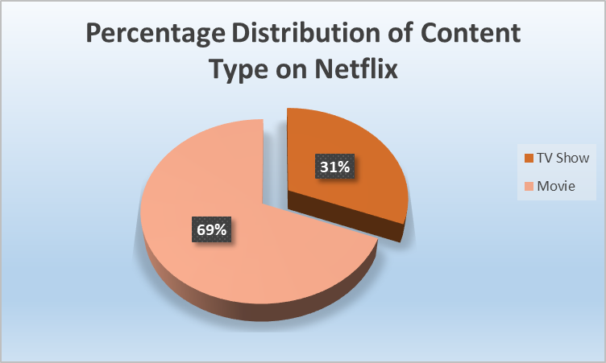
Content Structure By Category
The following chart demonstrates the distribution of the content by type - Movie vs. TV show added over the years.
Interestingly, 69% of the content on Netflix is Movies.

Slide 6
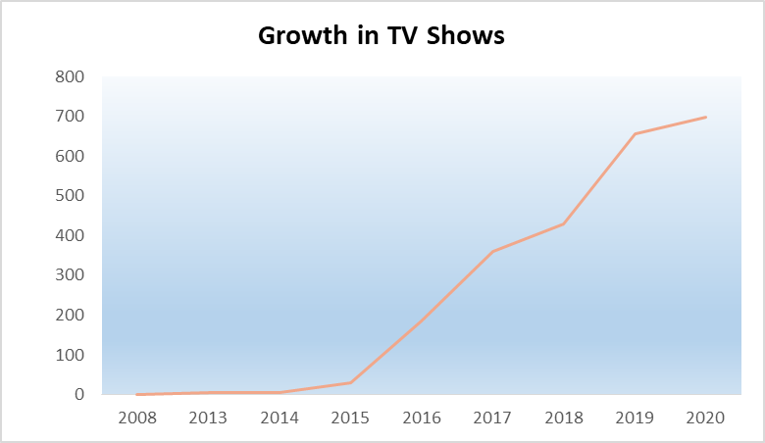
Content Addition by year
TV Shows
There has been a significant uptick in the addition of tv shows from 2015 onwards.
About 700 new tv shows were added in 2020, compared to 30 in 2015.

Slide 7
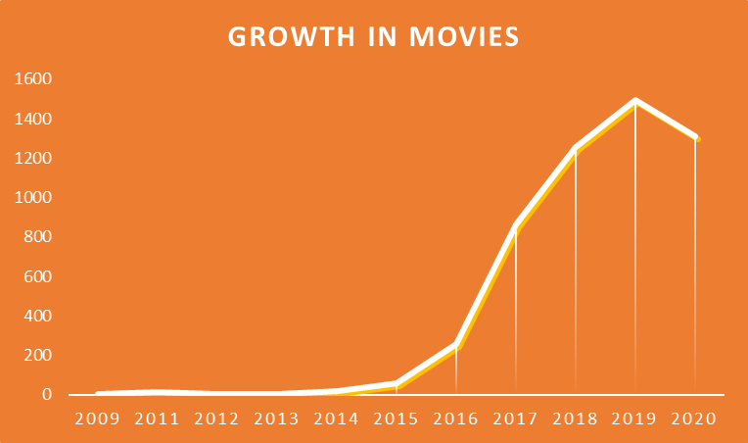
MOVIES
The growth in number of movies on Netflix is
much higher than in tv shows.
The growth in content started from 2015.
About 1500 new movies were added in 2019.
However, it declined by 12% in 2020.

Slide 8
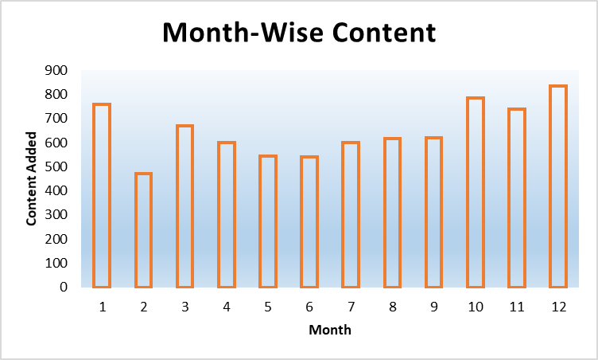
Content addition Dynamics by each month
Each month several movies and tv shows are added to Netflix’s library.
The month’s of December, January and October have so far witnessed the highest content addition over the years.

Slide 9
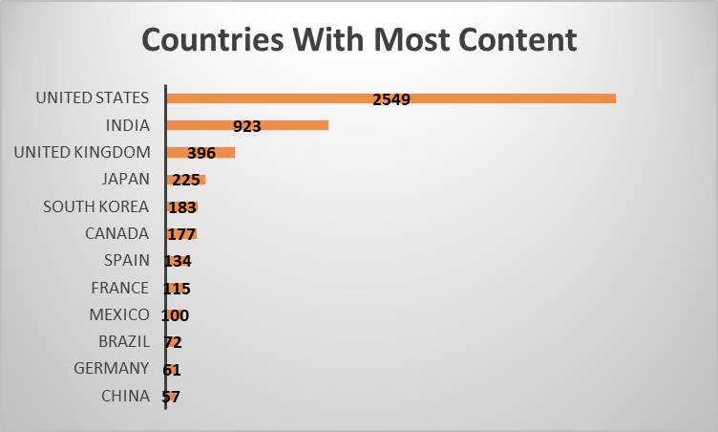
COUNTRIES PRODUCING MOST CONTENT
Just like most of the users expected, the country with most titles is the United States, which has added more than 2500 titles on Netflix.
The second most-involved country is India, which surpassed the UK , Japan, South Korea and Canada in the number of titles produced that can be streamed on Netflix.

Slide 10
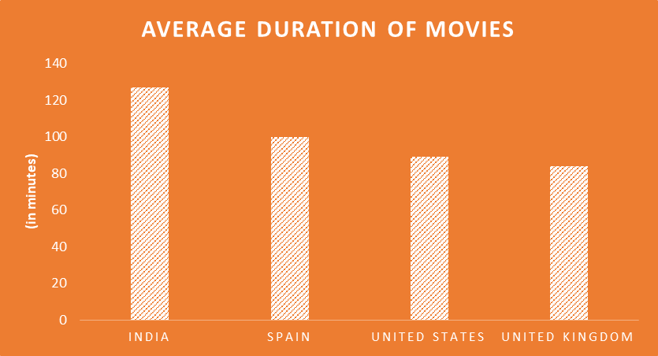
average length of the movies added
We have considered the countries –
USA, UK, India and Spain in the analysis of
average duration of the movies added
over the years.
According to this analysis, India has the
highest average length of movies compared
to other countries.
The average movie duration in India is 127
minutes, while that in UK is 84 minutes.

Slide 11
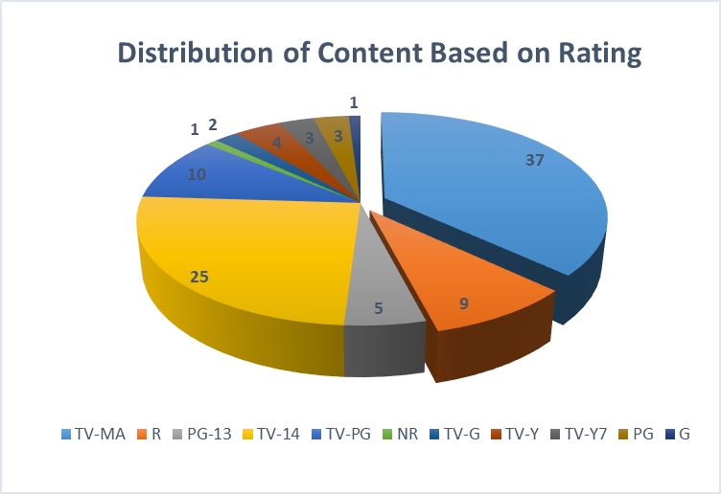
STRUCTURE OF CONTENT BY AGE RATING
In terms of age rating, Netflix offers plenty of content for its different age groups.
Most of the content on Netflix is suitable for adults (TV-MA : 17 and above), which constitutes 37% of all the content available on Netflix.
TV- 14 rating, which represents 14 years and above, constitutes 25% of all the content.
'Suitable for children' - TV-Y rating corresponds to only 4% of all available content.

Slide 12
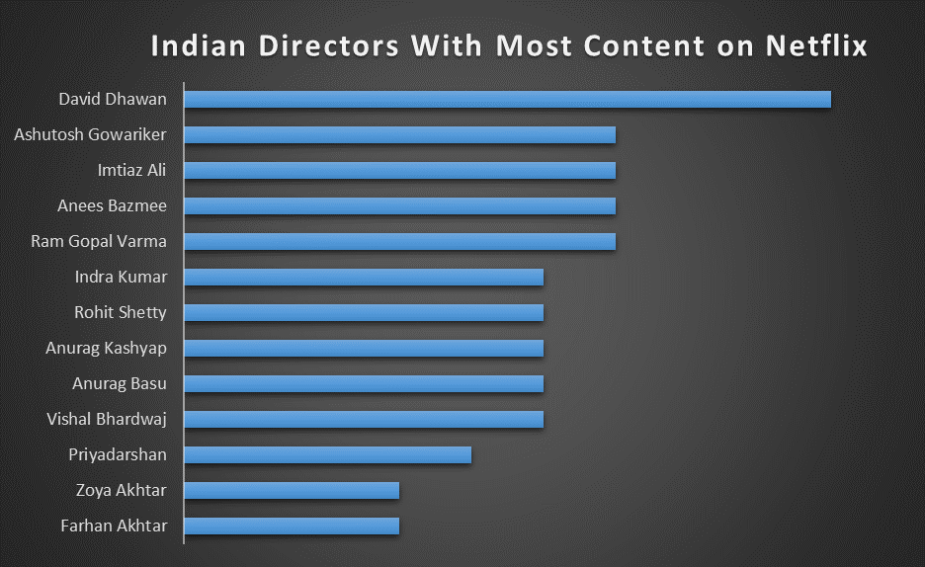
Directors with most content – India and USA
The chart displays the most popular directors across the Netflix platform in India.

Slide 13
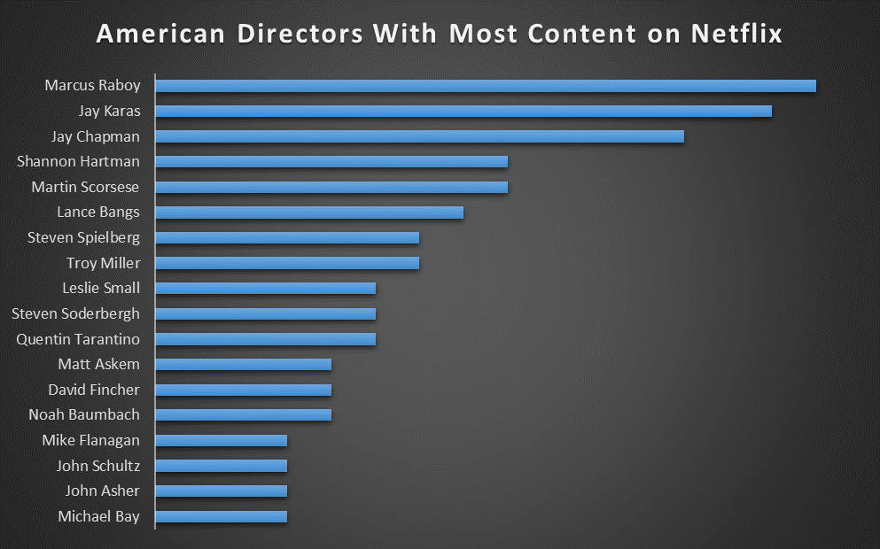
The chart displays the most popular directors across the Netflix platform in the United
States.

Slide 14
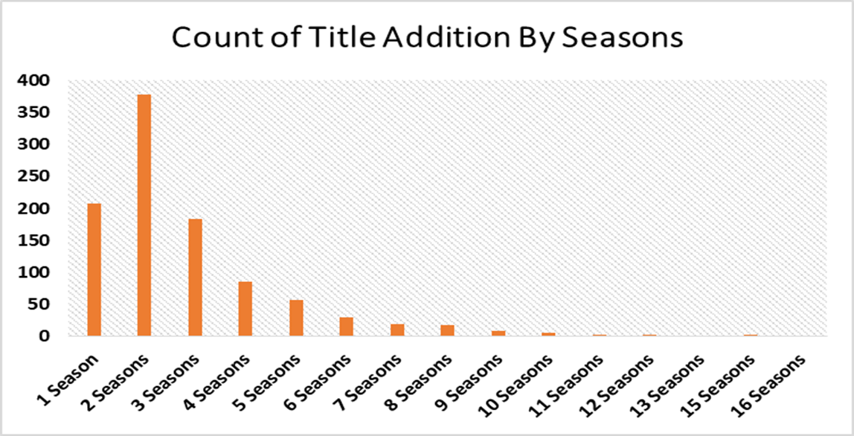
TV Show Structure BY Seasons
This analysis suggests that maximum tv shows on Netflix get cancelled after the second season.
Only a few Netflix shows have had longer lifespans.
There are only 2 shows with 11 seasons and 8 shows with 9 seasons.

Slide 15
CONCLUSION
Many interesting inferences have been drawn from this dataset. Here’s a summary of a few them:
Netflix has been adding more movies to please its users.
The streaming platform started gaining momentum after 2015. Since then, the amount of tv shows and movies added has been increasing significantly.
As expected, United States produces the maximum amount of content on Netflix.
Most of the content is added during the fall and winter months.
The most popular director on Netflix USA , with the most titles, is Marcus Raboy.
In terms of age rating, most of the content available is suitable for adults.
Most of Netflix’s tv shows get cancelled after only 2 seasons, with very few of them reaching 9 and 10 seasons.

Slide 16
BUSINESS RECOMMENDATIONS
Attempts should be made to bring back new seasons of TV Shows to retain subscribers.
TV content creation should be expanded to enhance user experience.
More contents should be added under TV-Y and TV-Y7 category, which are suitable for children.
More contents should be added from various countries like – China, Brazil, Germany and Mexico.
Attempts should be made to release new content during the summer months.

Slide 17

THANK YOU

